Slide 1

Creating a Data Backup
Oakland University
University Relations
Updated - June 2006

Slide 2
What Is A Backup?
A backup will take the data stored on your computer and transfer it to a safe, protected server where it will reside indefinitely.
In the event of a power outage, computer malfunction, or user error this data can be recovered to your PC, preventing permanent data loss.
Please Note: A backup is stored in a private drive on the server, protecting your data from unauthorized access. Nobody else will be able to view your backup.
A backup is not the same as what is stored on the J-drive. J-drive files are for sharing only. Backups will never be shared.

Slide 3
Why Create A Backup?
A backup will prevent permanent data loss, which could inhibit the achievement of the goals and strategies of the University Relations Department and the entire University.
Data Backup is a University policy. Here is a quote from the Policy of Use of University Information and Technology Resources:
  “You are responsible for the security and integrity of University information stored on your personal desktop system. This responsibility includes making regular disk backups, controlling physical and network access to the machine, and installing and using virus protection software. Avoid storing passwords or other information that can be used to gain access to other computing, network or information technology resources.”

Slide 4
The Backup Process
To complete a backup:
  Follow the steps outlined on the following pages.
  Be aware that the screen shots shown may differ from your PC (depending on your operating system, desktop, etc.).

Slide 5
NOTE
Please make sure that you are storing ALL documents on your PC in your “My Documents” folder. There should be absolutely NO files on your computer unless they are in “My Documents” except for the Banner Reports database which should not be in your “My Documents” folder as it is too big to be backed up by all users. We have a backup. Don’t worry!
Any files not in your “My Documents” folder will NOT be backed up!

Slide 6
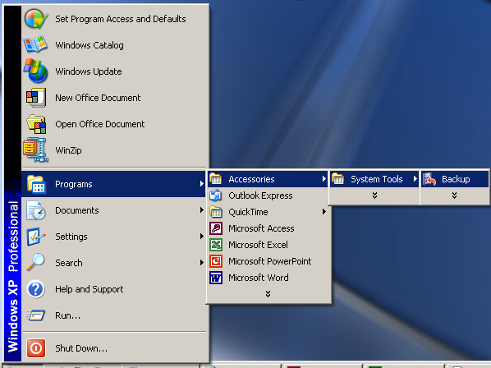
Opening the “Backup” program
1) Click “Start” – “Programs” – “Accessories” – “System Tools” – “Backup”

Slide 7
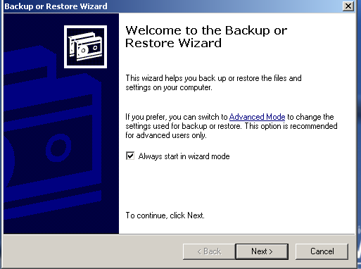
The Following Screen Should Open
2) Click the tab “Next” at the bottom of the screen

Slide 8
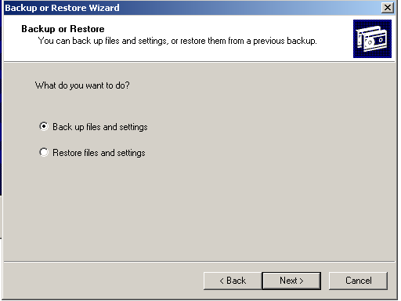
The Following Screen Should Open
3) Choose “Back up files and settings”.

Slide 9
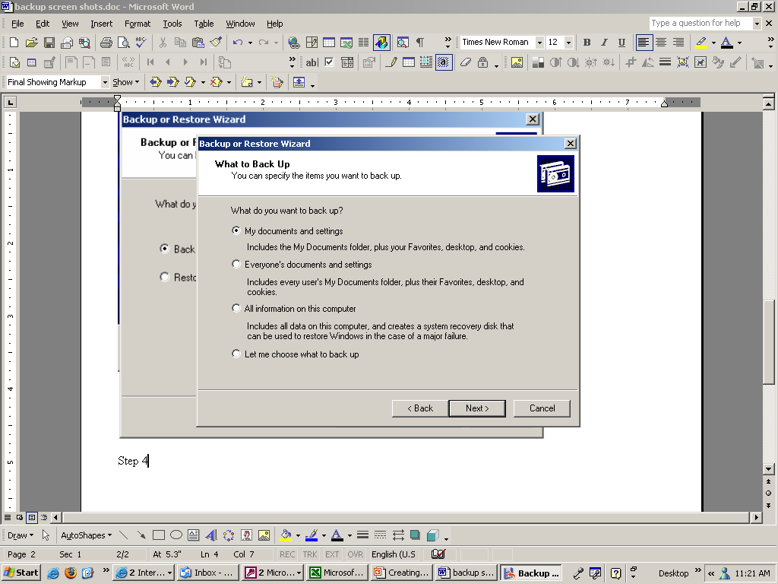
The Following Box Will Pop Up
4) Choose “My documents and settings”. If you have not done a disk cleanup in a while, you will have lots of “cookies” and the backup will take a long time. Either clean up your disk or choose the option “Let me choose what to back up”, then pick your “My Documents” folder. Please note this process does not backup your email. Please see Dawn Teolis or Rob Saunders for email backup locations.

Slide 10
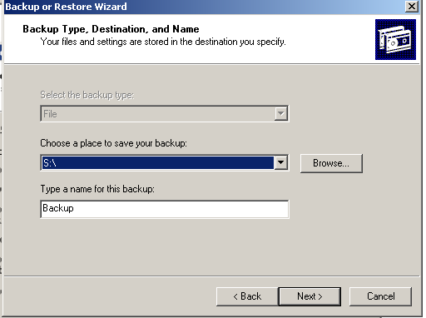
The Following Box Will Pop Up
5) Make sure you see the screen as shown above.

Slide 11
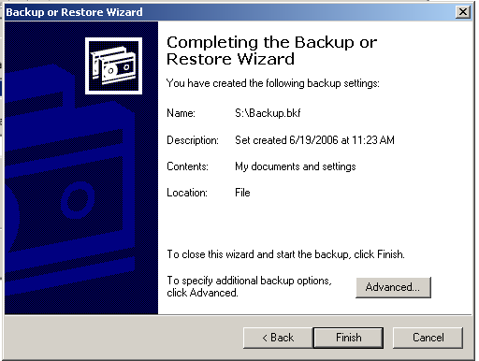
The Following Box Will Pop Up
6) Make sure you see the screen as shown above then click “Advanced”.

Slide 12
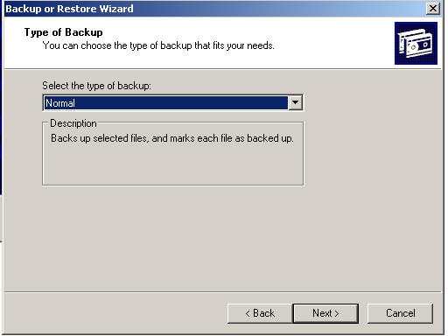
The Following Box Will Pop Up
7) Choose “Normal” type of backup.

Slide 13
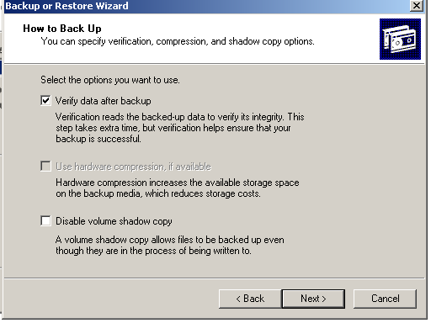
The Following Box Will Pop Up
8) Choose “Verify data after backup”.

Slide 14
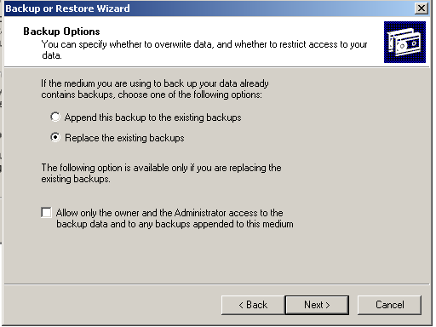
The Following Box Will Pop Up
9) Choose “Replace the existing backups”. If you don’t, your backup file will keep getting larger and larger.

Slide 15
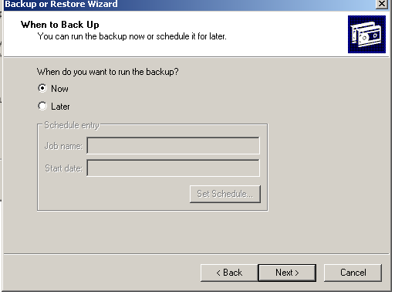
The Following Box Will Pop Up
10) Choose “Now” for when to start your backup.

Slide 16
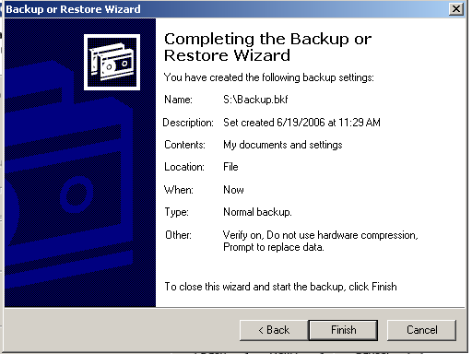
The Following Box Will Pop Up
11) Choose “Finish”.

Slide 17
Completing The Backup
After the backup is complete:
  Close the backup program.
  Perform a backup on a regular basis.
    It should be completed during times of lower JDH system activity.
      Lunch time
      Just before you leave
  In the event of data loss, please let either Dawn Teolis or Rob Saunders know so that we can recover your data.

